Slide 1

Introduction to Multiple Linear Regression
Predicting real-world outcomes using several key factors.

Slide 2
What is Multiple Linear Regression?
Defining MLR
House Price Prediction
Multiple Linear Regression (MLR) predicts a continuous outcome using several input factors simultaneously, instead of just one.
Think about predicting a house price. Instead of just square footage, MLR considers multiple features like:
Number of bedrooms
The model learns how important, or "weighted," each factor is to make an accurate prediction.
Location (e.g., school district rating)
Age of the house
Each column represents a different feature, like bedrooms or location, that helps predict the final outcome.

Slide 3




Why Do We Need Multiple Features?
Real-world outcomes are complex. Predicting them accurately often requires more than just one piece of information. Think about predicting house prices:
Local Economy
Home Age
Local income levels directly impact property values.
Newer homes generally sell for more; older ones might need updates.
Size & Rooms
Neighborhood
More bedrooms and living space usually mean higher prices.
Demand and amenities in the area affect market value.
By combining these details, we get a far more accurate and reliable house price prediction than relying on any single factor.

Slide 4






The California Housing Dataset
MedInc
HouseAge
Median income in block
Median house age
AveRooms
AveBedrms
Average rooms per household
Average bedrooms per household
Population
AveOccup
Block group population
Average household occupancy
We'll explore the California Housing dataset, real data from the 1990 California census. It lists median house values across districts, alongside various features that help us understand property prices.
Each entry represents a neighborhood, and our goal is simple: predict the median house value using these available characteristics. It's a great way to see how different factors influence home prices.
By understanding how these features relate to each other and to house values, we can better predict what makes a home desirable and valuable.

Slide 5



Feature Matrix and Target Vector
To predict things like house prices, we use two main ingredients: a "feature matrix" (X) and a "target vector" (y).
Think of X as a spreadsheet of information. Each row is a unique item (like one house), and each column is a piece of data about that item (like its size, age, or neighborhood).
The y is the answer key—the actual value we want to predict for each item in X (e.g., the actual price of each house).
Our goal is for a model to learn how to combine the data in X to guess the values in y as accurately as possible.
Feature Matrix (X)
Model Learns
Target Vector (Y)
All the data points and their characteristics.
Finds patterns in X to predict Y.
What we want to predict.

Slide 6

Feature Matrix and Target Vector - Example
Let's see this in action with a simple house price example:
1000
2
10
55
1500
3
5
82
800
2
20
40
Feature Matrix (X)
Target Vector (y)
The first three columns become our X - all the information we know about each house:
The last column is our y - what we want to predict:
House 1: $55,000
House 1: 1000 sq ft, 2 bedrooms, 10 years old
House 2: $82,000
House 2: 1500 sq ft, 3 bedrooms, 5 years old
House 3: $40,000
House 3: 800 sq ft, 2 bedrooms, 20 years old
Goal: The model learns how size, bedrooms, and age combine to predict price. Once trained, give it new house features and it predicts the price!

Slide 7
Finding the Best Fit: The Hyperplane in MLR
Think of simple prediction as drawing a straight line. With Multiple Linear Regression (MLR) and many factors, we fit a more complex "hyperplane"—a multi-dimensional line—to capture all the relationships in our data.
The "Recipe" for Prediction
Learning from Mistakes
MLR's goal is to find the perfect "recipe" (combination of weights) for each factor. It constantly adjusts these weights to make its predictions as close as possible to the actual results. Imagine a chef tweaking ingredients until the dish tastes just right.
The model learns by testing different weight combinations, much like a student trying various approaches to a math problem. It identifies and minimizes errors in its predictions. Once trained, it has a reliable formula: give it new information (e.g., house size, location) and it can predict the outcome (e.g., house price).

Slide 8
Example: Predicting House Price with Two Features
Suppose we want to predict house price using only two features: Size (in sqft) and Number of Bedrooms.
Your model might learn something like this:Price = 20 + 0.05(Size) + 5(Bedrooms)
For House A:
For House B:
Size = 1000 sqft
Size = 1500 sqft
Bedrooms = 2
Bedrooms = 3
Prediction:20 + 0.05(1000) + 5(2)= 20 + 50 + 10= 80 lakh Tk
Prediction:20 + 0.05(1500) + 5(3)= 20 + 75 + 15= 110 lakh Tk
Each combination of features gives a point in space, and the model finds the plane that passes closest to all those points—that's the hyperplane!

Slide 9
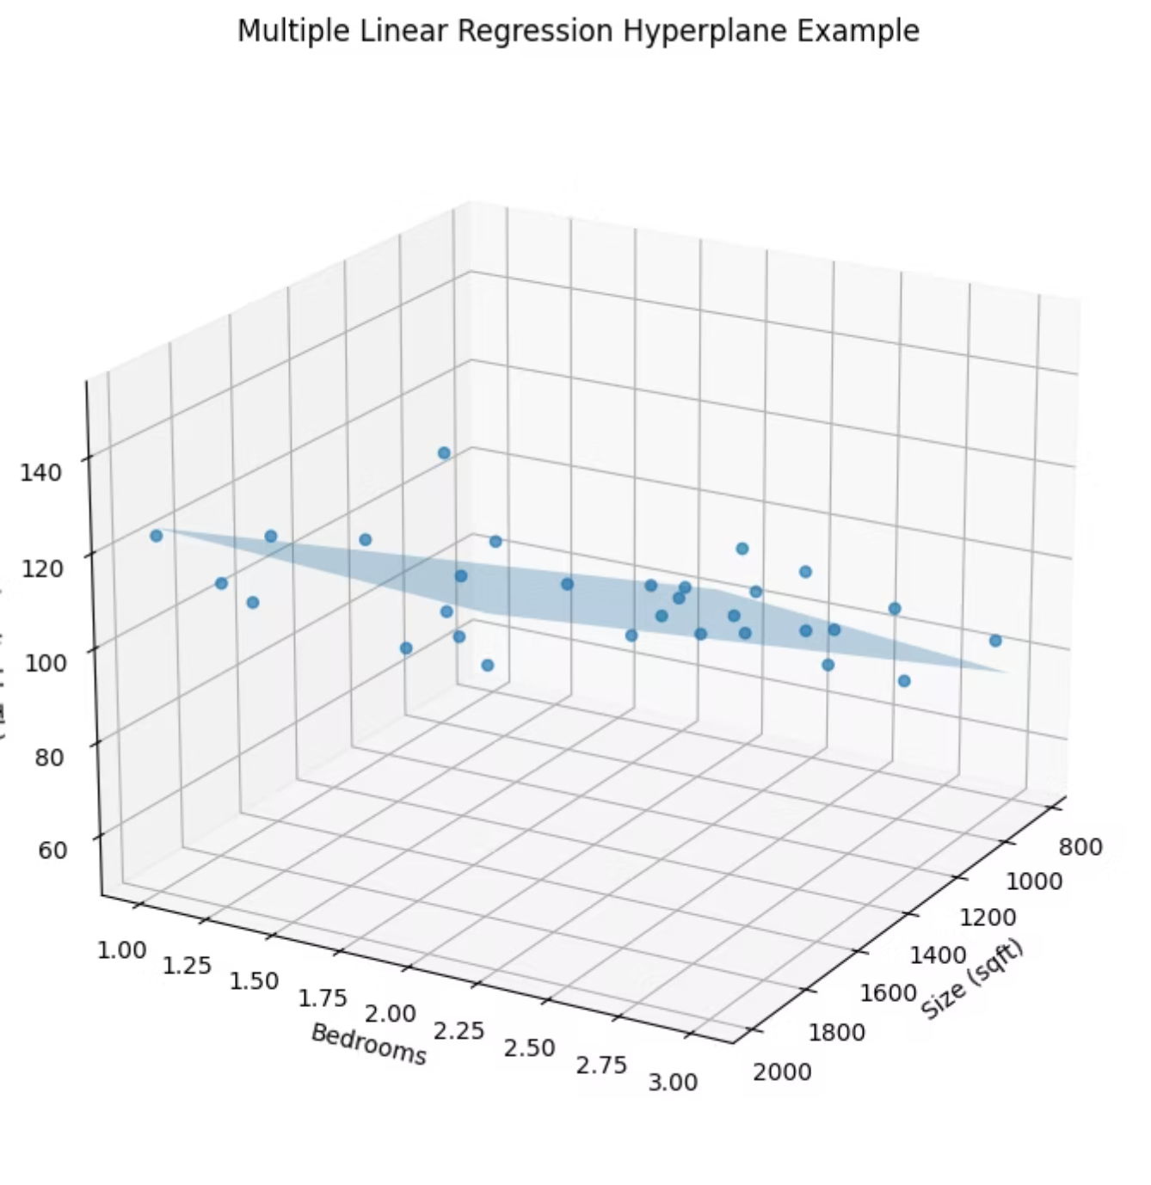
Visualizing the Hyperplane
This 3D graph shows how Multiple Linear Regression works with two features (Size and Bedrooms) to predict house prices.
Each blue dot represents a real house with its actual price
The flat blue plane is the hyperplane—the model's best guess at the relationship
The plane tries to get as close as possible to all the dots
Think of it like this: if you know a house's size and number of bedrooms, you can find that spot on the plane and read off the predicted price. The model learned the perfect angle and position for this plane by studying all the real house data (the dots).

Slide 10

Building Our First Predictive Model
Time to apply what we've learned! Let's build our first predictive model step-by-step.
Gather Data
1
Collect all relevant information.
Understand Data
2
Examine trends and patterns.
Organize Data
3
Separate what to predict from what predicts it.
Spot Connections
4
See how variables relate to each other.
Ready to code? Open your notebook and follow along to build a powerful predictive model!

